Slide 1
Camera Traffic Counts
By: John Trelford, Lucas Chiang, Travis Welsh, Brian Pham, and Ritesh Penumatsa
(Group 11)

Slide 2
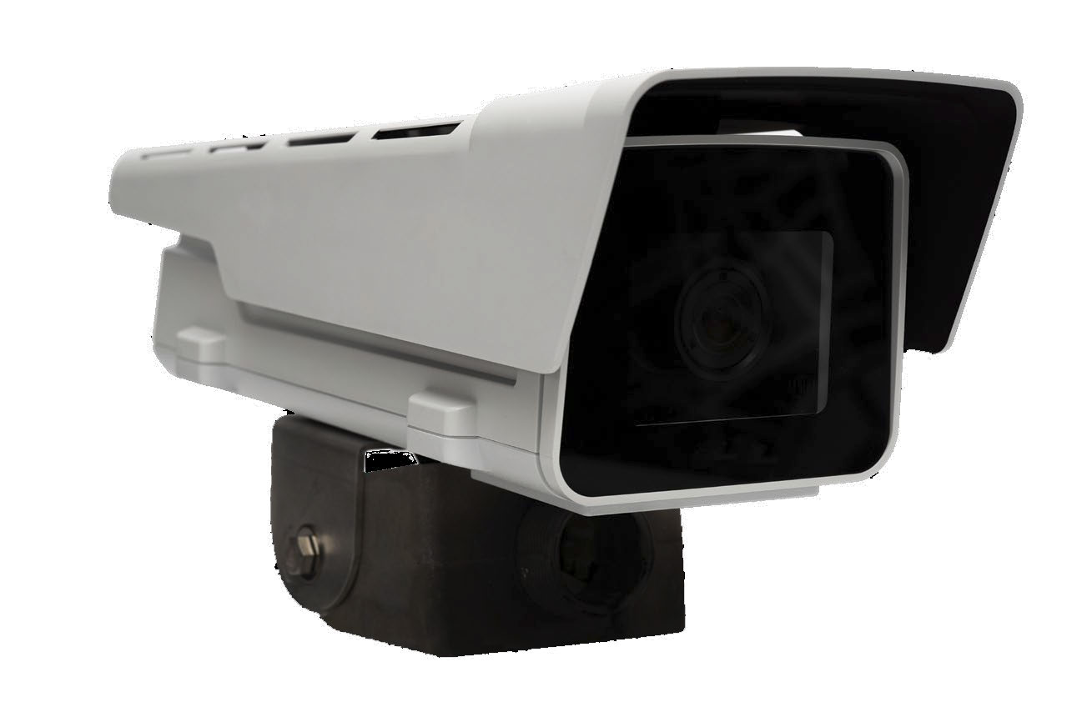
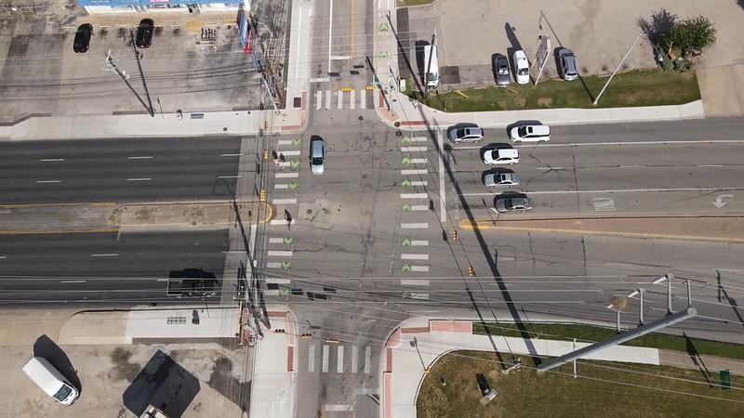
Dataset Overview
Camera Traffic Counts:
15-minute interval traffic by intersection in Austin
Collected by GRIDSMART optical traffic detectors
AC3 Camera (traffic detector)

Slide 3
Subsetted Data
How?
Filter to only rows where year = 2019
Why?
Prevents interference from the COVID-19 pandemic period
The full Camera Traffic Counts dataset was 82.1 million rows
  Overwhelms RAM
  Computationally Intensive

Slide 4
Features
Shape - (Rows; Columns): (14,717,624; 19)
Non-Exhaustive List of Features:
Month, Day, Year, Hour, Minute, Day of Week
Speed Average - average vehicle speed entering the intersection during the interval
Seconds in Zone Average - average time vehicles spent in the intersection
Heavy Vehicle - Vehicles equal to or longer than 17 feet
Volume - The number of vehicles traveling in the respective direction and making the respective turning movement during the 15-minute interval
Direction (approaching the intersection)

Slide 5
Hypothesis #1:
People tend to drive slower toward the end of the week

Slide 6
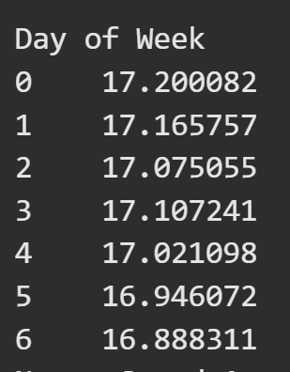
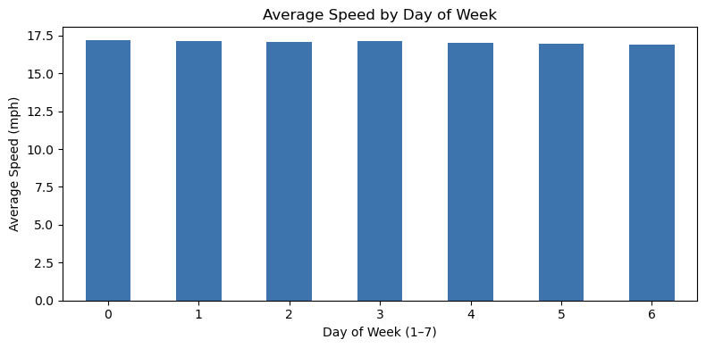
Results

Slide 7
Hypothesis #2
People tend to drive less on weekends

Slide 8
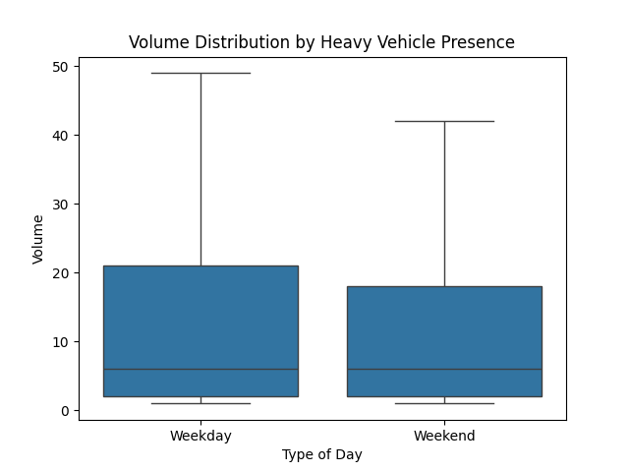
Box Plot
They appear to be visually similar at the lower half of the data
Difference becomes evident as you view the higher percentiles
Likely still significant due to the large size of the dataset (14 million rows)

Slide 9
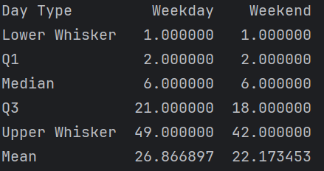
Numerical Analysis
Median and Lower Quartile are the same, likely due to late hours and off roads receiving minimal traffic regardless of day
Difference becomes evident when looking at the mean and upper quartile

Slide 10

T-Test
Because the p-value is less than .05, there is significant evidence to support that the means for volume on weekends and weekdays are significantly different

Slide 11
Hypothesis 3
Vehicles drive more slowly on average around 9AM and 5PM.

Slide 12
Hypothesis Test
(Null Hypothesis): The average vehicle speed at around 9AM and 5PM is greater than or equal to the average speed during non-rush hour.
(Alternative Hypothesis): The average vehicle speed at around 9AM and 5PM is significantly lower than during non-rush hour.
Significance Level (α): 0.05

Slide 13
Methodology
Two-Sample T-Test (Statistical Analysis)
This test was conducted to determine if the average speeds of two distinct groups—morning traffic and evening traffic—are significantly different compared to other times.

Slide 14
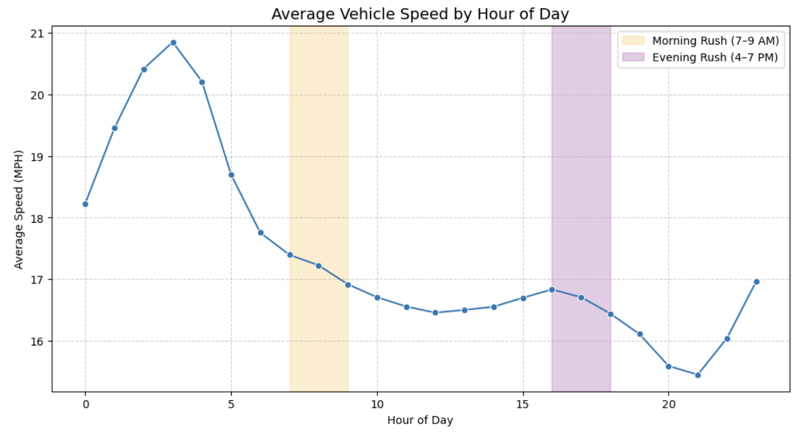

Slide 15
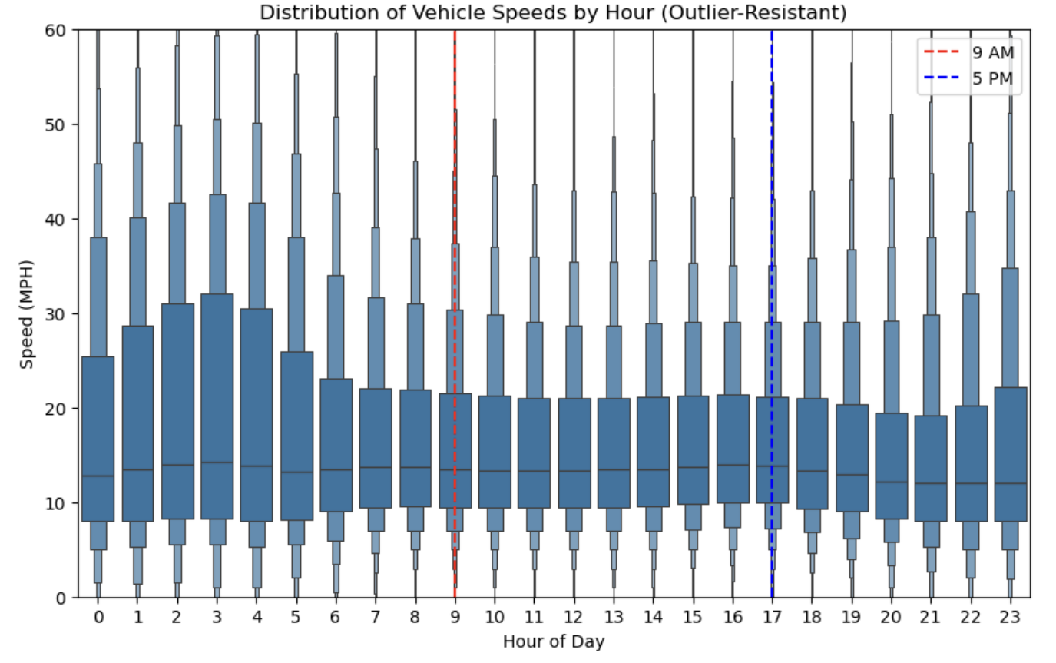

Slide 16
Methodology cont.
Results: The test produced a t-statistic and a one-tailed p-value for our alternative hypothesis.
  t-statistic: -29.564346384176176
  p-value: 2.194520763113896e-192
Conclusion: With a p-value of 2.2e-192 (less than α=0.05), we reject the null hypothesis. The results provide overwhelming statistical evidence that vehicles drive significantly slower during the designated rush hour periods.

Slide 17
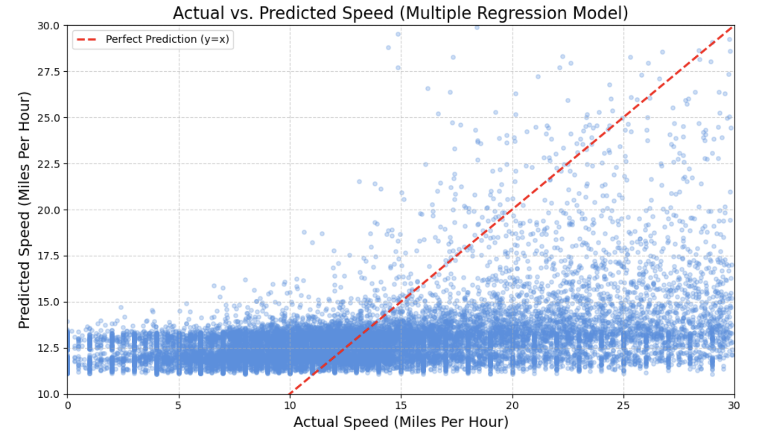
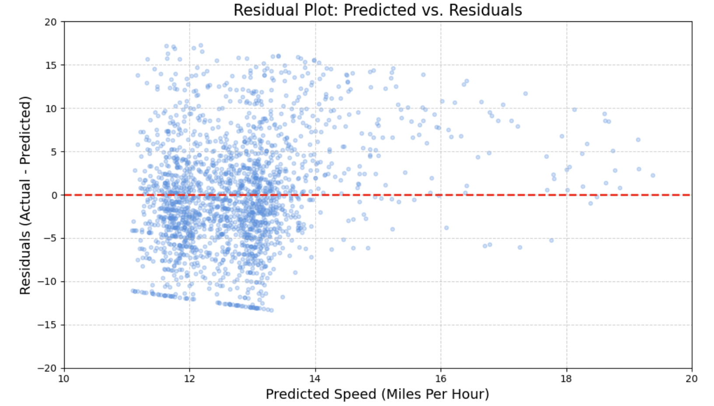
Linear Regression Model
Data Preparation: We selected the following input features and the target variable for our model.
Input (X): Hour, Day of Week, Volume, Heavy Vehicle, Direction.
Target (y): Speed Average (Miles Per Hour).

Slide 18
Model Evaluation (Account for Confounders)
--- Model Coefficients (Feature Importance) ---
Direction_SOUTHBOUND -1.087741
Direction_NORTHBOUND -0.475226
Direction_WESTBOUND -0.380772
Hour -0.186419
Day of Week -0.072805
Volume 0.067215
Direction_UNASSIGNED 2.548512
Heavy Vehicle 2.752015
--- Regression Performance Report ---
R-squared (R²): 0.1465
Mean Absolute Error (MAE): 6.3918 MPH
Mean Squared Error (MSE): 8.4158 MPH
The 'Unassigned Direction' and 'Heavy Vehicle' coefficients are typically the most important. A negative coefficient (e.g., for Hour) means as that factor increases, speed decreases. The MAE indicates that the model's predictions are, on average, off by that many MPH.

Slide 19
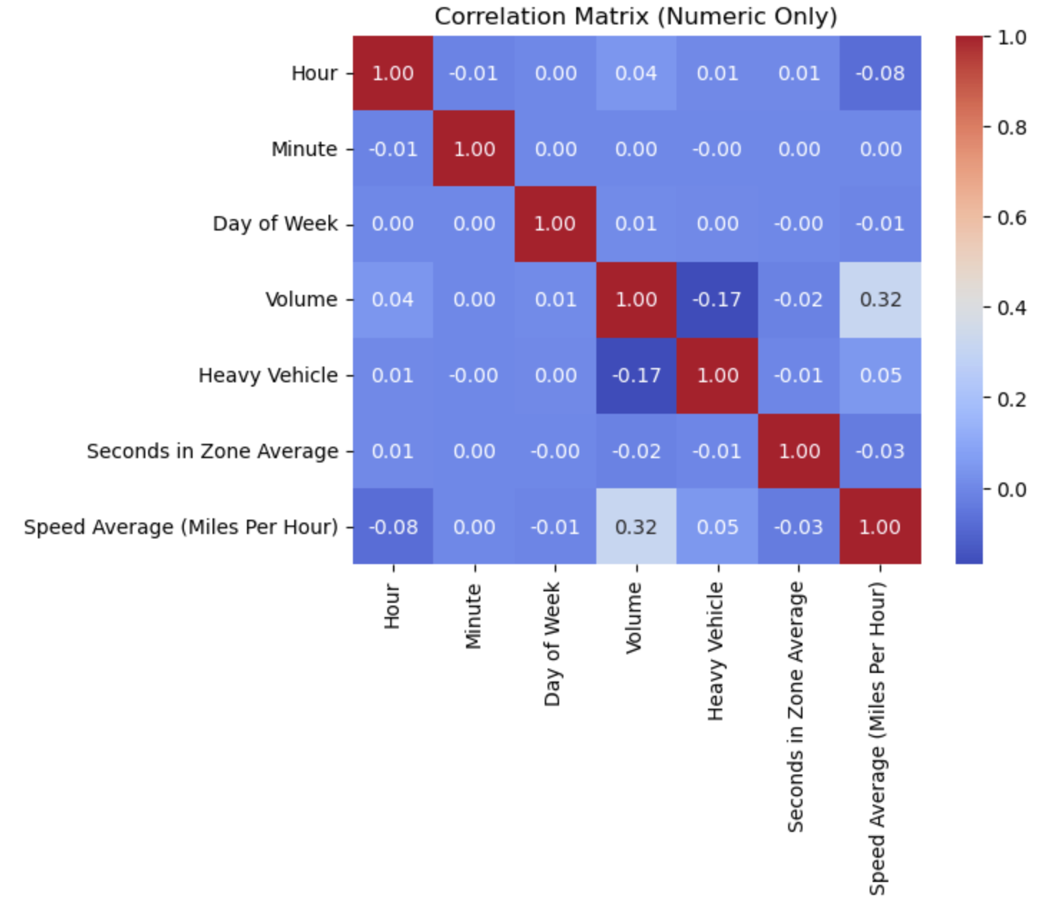

Slide 20
Hypothesis 4
Cars tend to move faster at turns when there is a heavy vehicle present

Slide 21
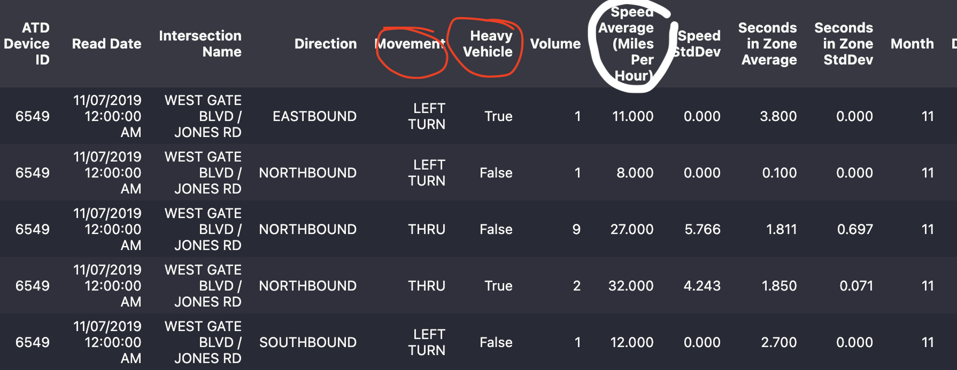
Methodology
Filtered the records based on the movement column (the vehicle movement the detector is positioned to capture) and extracted the records that indicated a turn (left turn or right turn)
Created charts comparing the average speeds recorded when there are heavy vehicles present and when there isn’t and conducted one-sided Welch’s T-Test

Slide 22
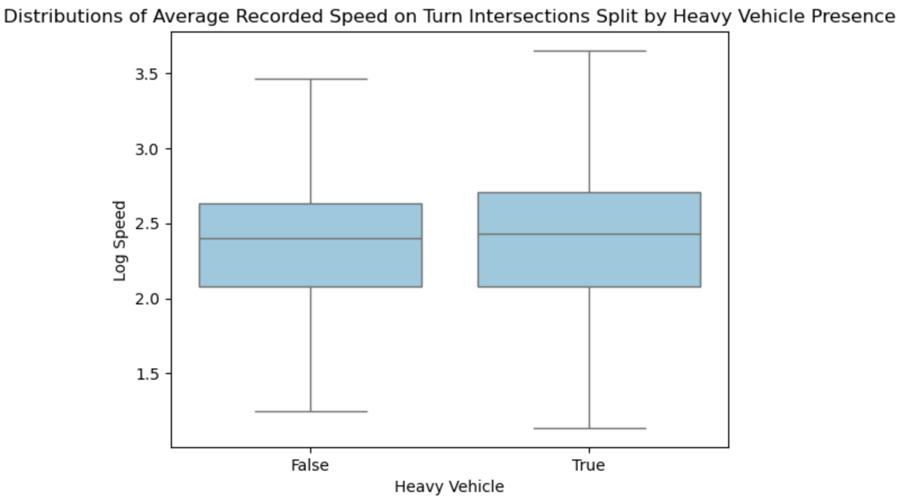

Slide 23
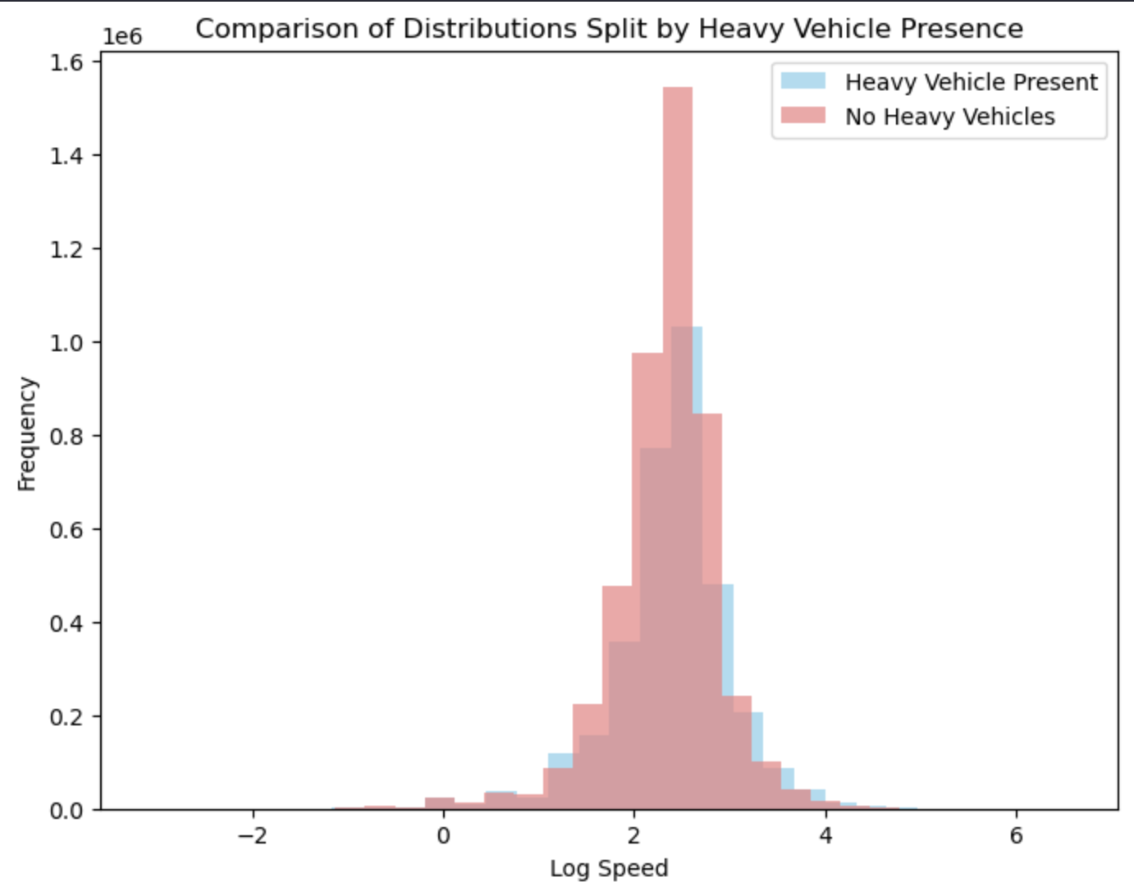
Heavy Vehicle Presence = True:
Mean Log Average Recorded Speed =
2.379
Heavy Vehicle Presence = False:
Mean Log Average Recorded Speed =
2.334

Slide 24
Welch’s T-Test
(Null Hypothesis): The Mean Average Recorded Speed at turn intersections is equal when Heavy Vehicle Presence is True and when Heavy Vehicle Presence is False.
(Alternative Hypothesis): Mean Average Recorded Speed is greater when Heavy Vehicle Presence is True
Significance Level (α): 0.05
:

Slide 25
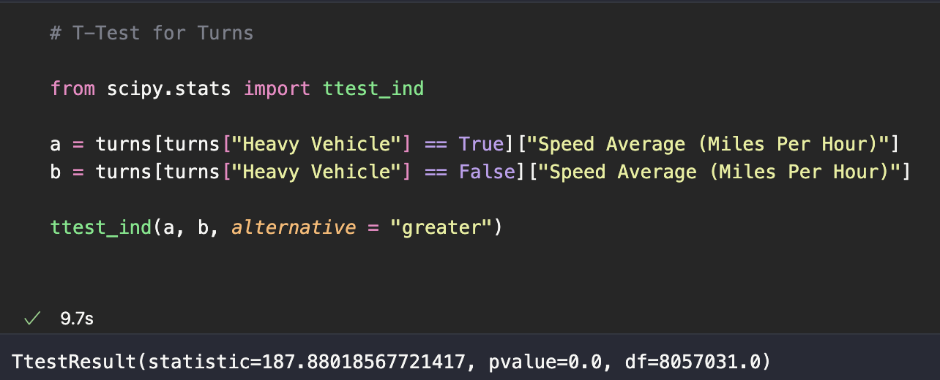
Welch’s T-Test Results

Slide 26
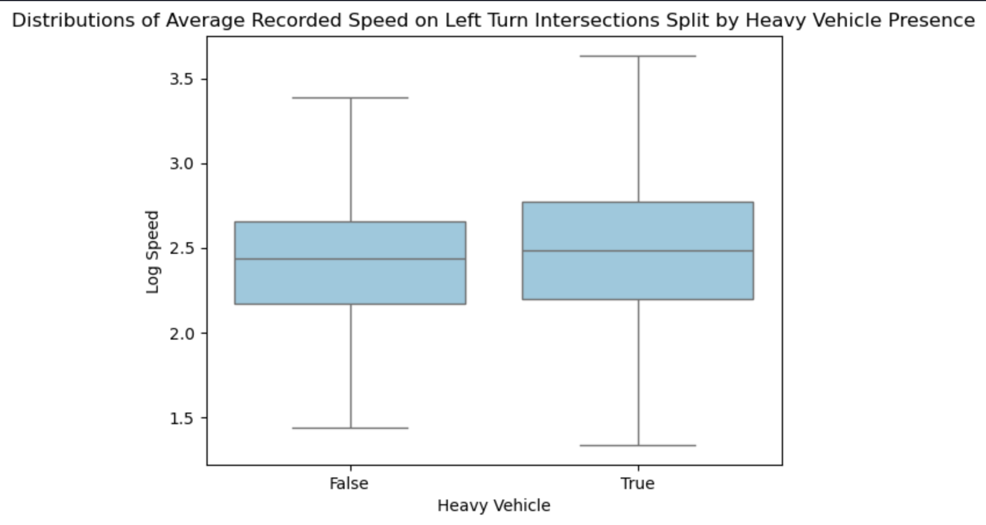
Results for Left Turn

Slide 27

Results for Right Turn

Slide 28
Takeaways
There is statistical evidence to suggest that drivers are driving faster at turns when there is a heavy vehicle.
Possible Explanations: Maybe the drivers in heavy vehicles are driving faster or people may want to pull ahead of heavy vehicles at intersections

Slide 29
Summary
Hypothesis #1
People drive slower later in the week
Hypothesis #3
People drive slower during rush hour
Hypothesis #2
People drive less on weekends
Hypothesis #4
People drive at higher speeds during turns when a heavy vehicle is present

Slide 30
Thank you!
Questions?

